Slide 1
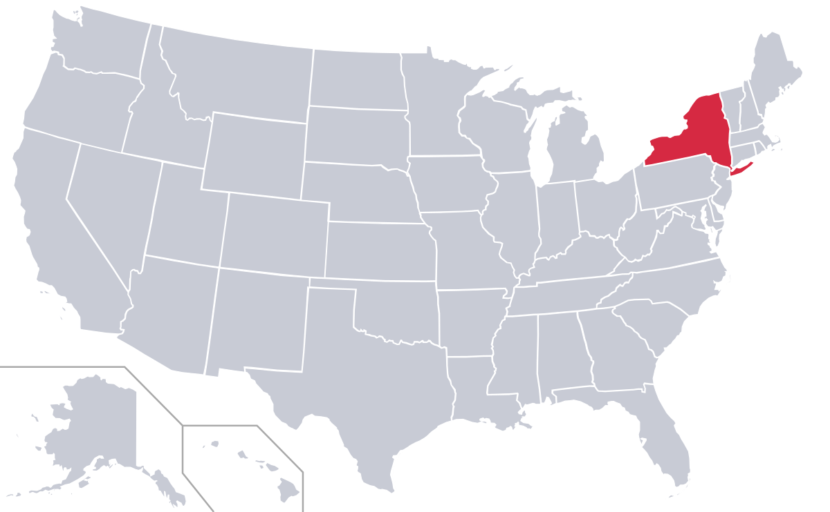
What is the behavior that obesity and overweight in adults had from 2011 to 2021? Is NY above the US metrics?
Why is it important?
The higher your BMI, the higher your risk for certain diseases such as heart disease, high blood pressure, type 2 diabetes, gallstones, breathing problems, and certain cancers (NHLBI, n.d.).
Presented by: Anny Cruz Salcedo

Slide 2
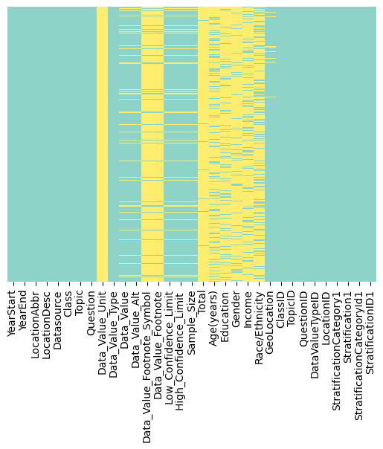
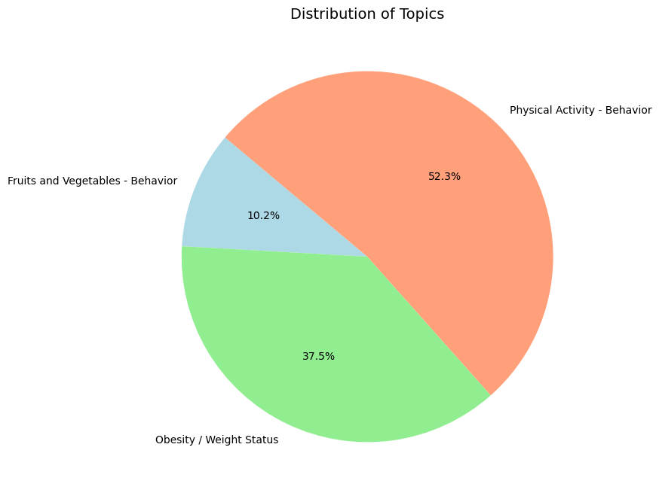

Data source
#visualizing which columns have missing values
The “Nutrition, Physical Activity, and Obesity - Behavioral Risk Factor Surveillance System” dataset was found in data.gov
It includes data on adult's diet, physical activity, and weight status from Behavioral Risk Factor Surveillance System. Provides national and state specific data on obesity, nutrition and physical activity.
The Behavioral Risk Factor Surveillance System (BRFSS) is the nation’s premier system of health-related telephone surveys that collect state data about U.S. residents (CDC, 2023).
The dataset contains 88,629 rows and 33 columns.

Slide 3
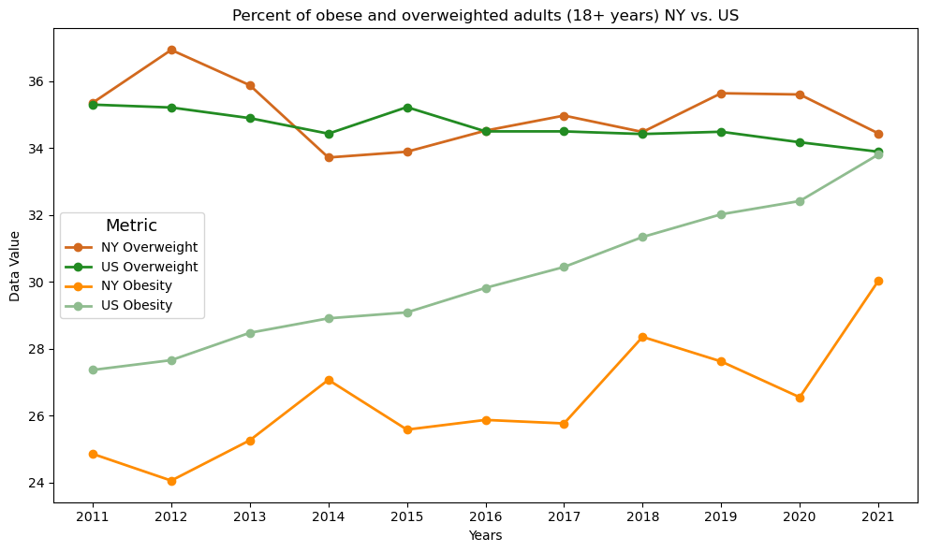
Methodologies: mathematical and statistical approaches (quantitative analysis), time series analysis.
Python libraries: pandas, NumPy, seaborn and matplotlib.
Types of visualizations: heatmap, pie, bars and line plots.
Data cleaning: converting non-null values as ”Data not reported” to null values, dropping rows with missing values in the ”Data_Value” column.
Transformations: renaming columns, data wrangling, creating new data frames, filtering by specific factors.

Slide 4
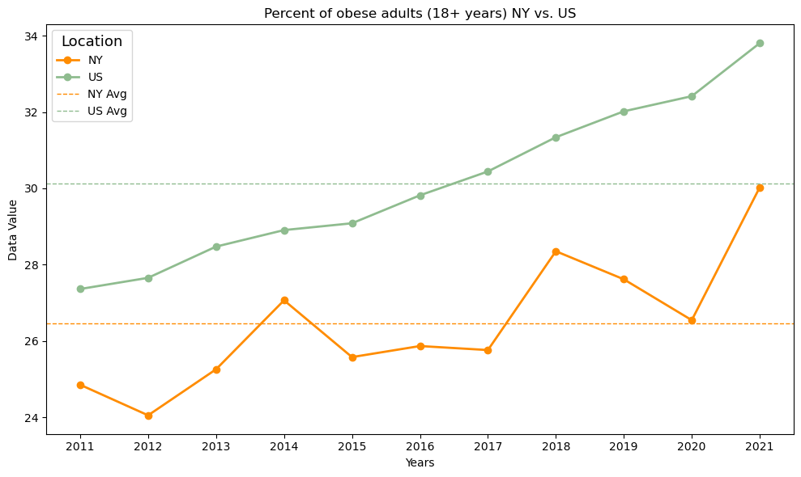
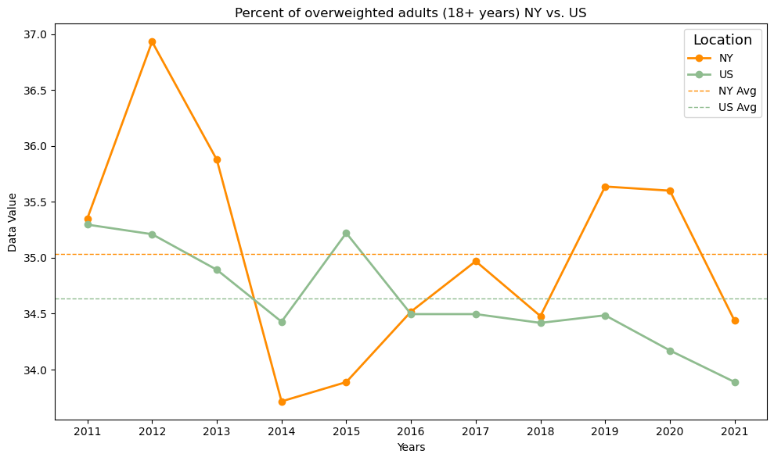

Slide 5
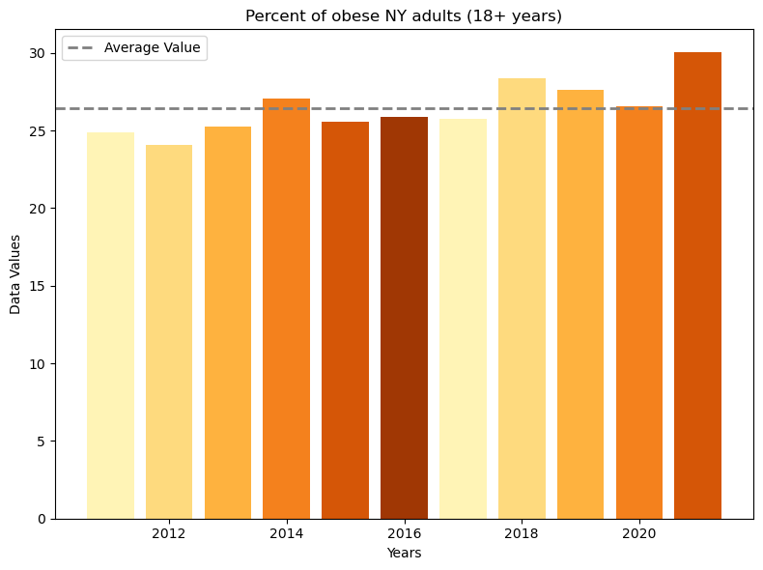
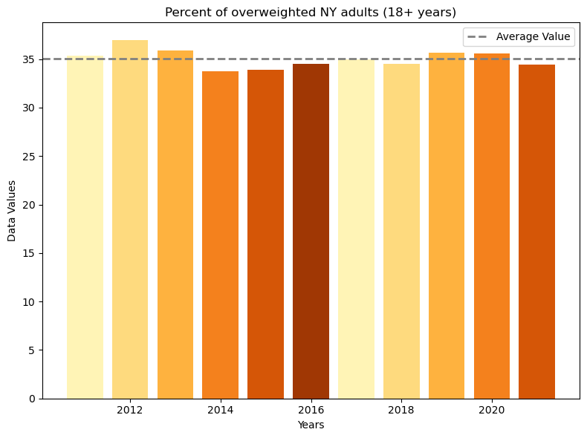
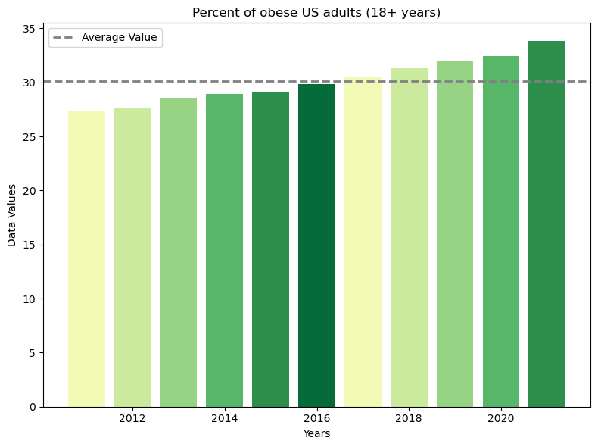
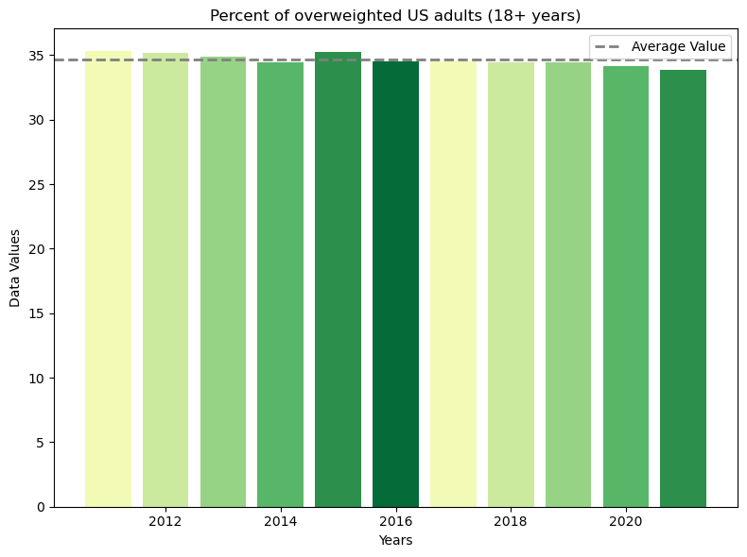

Slide 6

conclusions
2021 was the year with the highest average of obese people both in NY and the US.
Within the 2011-2021 period, the average of obese New Yorkers was lower than the national average.
2012 was the year with the highest average of overweighted people in NY, while nationally, but not by much, was 2011.
Within the 2011-2021 period, the average of overweighted New Yorkers was slightly higher than the national average.
Overall, there is a clear rising trend in the obese category within the country.

Slide 7
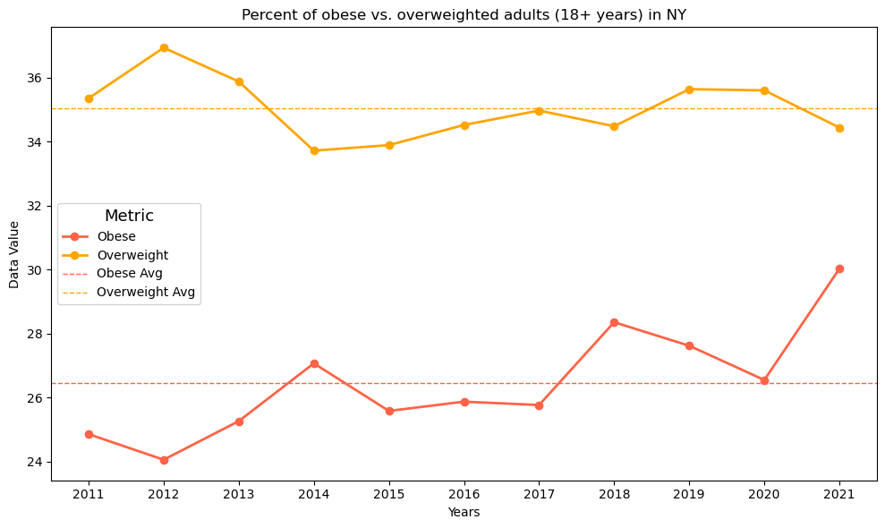
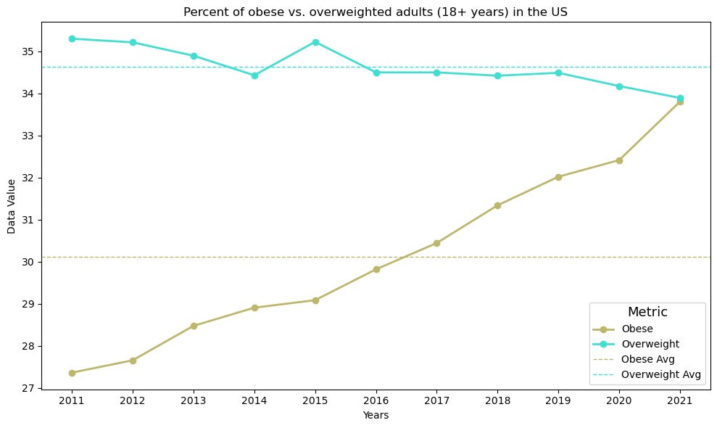
REFERENCES
U.S. Department of Health and Human Services. (2023, July 29). Nutrition, Physical Activity, and Obesity - Behavioral Risk Factor Surveillance System. Data.gov. https://catalog.data.gov/dataset/nutrition-physical-activity-and-obesity-behavioral-risk-factor-surveillance-system
Centers for Disease Control and Prevention. (2023, May 5). Behavioral Risk Factor Surveillance System (BRFSS). CDC. https://www.cdc.gov/brfss/index.html
National Heart, Lung, and Blood Institute. (n.d.). Assessing your weight and health risk. NHLBI. https://www.nhlbi.nih.gov/health/educational/lose_wt/risk.htm

